Slide 1
Java 8

Slide 2
It was 2014 That’s a long time ago but still many projects are running on Java 8. It’s because it was a major release with a lot of new features. Let’s look at all the exciting and major features of Java 8 with example code.

Slide 3
Some of the important Java 8 features are;
forEach() method in Iterable interface
default and static methods in Interfaces
Functional Interfaces and Lambda Expressions
Java Stream API for Bulk Data Operations on Collections
Java Time API
Collection API improvements
Concurrency API improvements
Java IO improvements

Slide 4
Lambda Expression
It provides a clear and concise way to represent one method interface using an expression. It is very useful in collection library. It helps to iterate, filter and extract data from collection.
The Lambda expression is used to provide the implementation of an interface which has functional interface. It saves a lot of code. In case of lambda expression, we don't need to define the method again for providing the implementation. Here, we just write the implementation code.

Slide 5
Lambda in Practice ( Things to keep in
Mind)
( ) -> Single Statement or Expression; // curly braces are not
needed.
( )-> { <Multiple Statements> }; // curly braces are needed for
multiple //statements

Slide 6
Lambdas vs Legacy Java(until Java7)
Legacy:
Runnable runnable = new Runnable() {
@Override
public void run() {
System.out.println("Inside Runnable 1");
}
};
Java 8:
Runnable runnableLambda = () -> {System.out.println("Inside Runnable
2");};

Slide 7
Functional Interfaces
By object-oriented programming language, we can declare that everything present in the Java programming language rotates throughout the Objects, except for some of the primitive data types and primitive methods for integrity and simplicity. There are no solely functions present in a programming language called Java. Functions in the Java programming language are part of a class, and if someone wants to use them, they have to use the class or object of the class to call any function.
@FunctionalInterface:
• This annotation is introduced as part of the JDK 1.8.
• Optional annotation to signify an interface as Functional Interface.

Slide 8
// Java program to demonstrate lambda expressions to
// implement a user defined functional interface.
@FunctionalInterface
interface Square {
int calculate(int x);
}
class Test {
public static void main(String args[])
{
int a = 5;
// lambda expression to define the calculate method
Square s = (int x) -> x * x;
// parameter passed and return type must be
// same as defined in the prototype
int ans = s.calculate(a);
System.out.println(ans);
}
}

Slide 9
Java SE 8 included four main kinds of functional interfaces which can be applied in multiple situations. These are:
Consumer
Predicate
Function
Supplier

Slide 10
1. Consumer
The consumer interface of the functional interface is the one that accepts only one argument or a gentrified argument. The consumer interface has no return value. It returns nothing.
Uses accept()

Slide 11
Consumer<String> c1 = (s) -> System.out.println(s.toUpperCase());
c1.accept("java8");

Slide 12
2. Predicate
a predicate functional interface of java is a type of function which accepts a single value or argument and does some sort of processing on it, and returns a boolean (True/ False) answer. The implementation of the Predicate functional interface also encapsulates the logic of filtering (a process that is used to filter stream components on the base of a provided predicate) in Java.
test()

Slide 13
Predicate<Integer> lesserthan = i -> (i < 18);
// Calling Predicate method
System.out.println(lesserthan.test(10));

Slide 14
Predicate Chaining
Predicate<Integer> greaterThanTen = (i) -> i > 10;
// Creating predicate
Predicate<Integer> lowerThanTwenty = (i) -> i < 20;
boolean result = greaterThanTen.and(lowerThanTwenty).test(15);
System.out.println(result);
// Calling Predicate method
boolean result2 = greaterThanTen.and(lowerThanTwenty).negate().test(15);
System.out.println(result2);

Slide 15
3. Function
A function is a type of functional interface in Java that receives only a single argument and returns a value after the required processing. Hence this functional interface takes in 2 generics namely as follows:
T: denotes the type of the input argument
R: denotes the return type of the function
The lambda expression assigned to an object of Function type is used to define its apply() which eventually applies the given function on the argument.

Slide 16
4. Supplier
The Supplier functional interface is also a type of functional interface that does not take any input or argument and yet returns a single output. Hence this functional interface takes in only one generic namely:-
T: denotes the type of the result
The lambda expression assigned to an object of Supplier type is used to define its get() which eventually produces a value. Suppliers are useful when we don’t need to supply any value and obtain a result at the same time.

Slide 17
5. BiConsumer-
Bi-Consumer is the most exciting variant of the Consumer interface. The consumer interface takes only one argument, but on the other side, the Bi-Consumer interface takes two arguments. Both, Consumer and Bi-Consumer have no return value. It also returns nothing just like the Consumer interface. It is used in iterating through the entries of the map.

Slide 18
6. Bi-Predicate – Bi-Predicate is also an extension of the Predicate functional interface, which, instead of one, takes two arguments, does some processing, and returns the boolean value.

Slide 19
7. Bi-Function – The Bi-Function is substantially related to a Function. Besides, it takes two arguments, whereas Function accepts one argument.

Slide 20
Unary Operator and Binary Operator –
There are also two other functional interfaces which are named as Unary Operator and Binary Operator. They both extend the Function and Bi-Function, respectively. In simple words, Unary Operator extends Function, and Binary Operator extends Bi-Function.
The prototype of the Unary Operator and Binary Operator is given below –
1. Unary Operator
@FunctionalInterface
public interface UnaryOperator<T> extends Function<T, U>
{
……...
}

Slide 21
2. Binary Operator
@FunctionalInterface
public interface BinaryOperator<T> extends BiFunction<T, U, R>
{
……...
}

Slide 22
Method Reference
The Java Lambda expressions allow us to define an anonymous method and treat it as an instance of functional interface. Similarly, the Method references allow us to do the same thing, but with the existing methods. Also, the Method References are similar to Lambda expressions, that they require a target type. But instead of providing implementation of a method, they refer to a method of an existing class or object.

Slide 23
Syntax of Method Reference
ClassName::instance-methodName
ClassName::static-methodName
Instance::methodName

Slide 24
Where to use Method Reference?
Lambda expressions referring to a method directly.
Using Lambda:
Function<String,String> toUpperCaseLambda = (s)->s.toUpperCase();
Using Method Reference:
Function<String,String> toUpperCaseMethodRefernce =
String::toUpperCase;

Slide 25
Where Method Reference is not Applicable ?
Example:
Predicate<Student> predicateUsingLambda = (s) -> s.getGradeLevel()>=3;

Slide 26
consumerMethodReference example
package com.learnJava.methodreference;
import com.learnJava.data.Student;
import com.learnJava.data.StudentDataBase;
import java.util.function.Consumer;
public class ConsumerMethodReferenceExample {
/**
* classname::methodName
*/
static Consumer<Student> c1= System.out::println;
static Consumer<Student> c2= Student::printListOfActivities;
public static void main(String[] args) {
StudentDataBase.getAllStudents().forEach(c1);
StudentDataBase.getAllStudents().forEach(c2);
}
}

Slide 27
Functional method reference
import java.util.function.Function;
public class FunctionMethodReferenceExample {
static Function<String,String> toUpperCaseLambda = String::toUpperCase;
static Function<String,String> toUpperMethodReference = String::toUpperCase;
public static void main(String[] args) {
System.out.println(toUpperCaseLambda.apply("java8"));
System.out.println(toUpperMethodReference.apply("java8"));
}
}

Slide 28
Constructor Reference
The Constructor reference mechanism is yet another game changing addition by Java 8. You can pass references to constructors as arguments or assign to a target type. Similar to method references, you can refer previously defined constructors and assign to a target type of a Functional Interface.
Moreover, in the constructor reference expressions, instead of specifying the exact constructor, we just write new. However, a class may have multiple constructors. In that case, compiler checks the type of the target functional interface with each of the constructors in the class, and finally chooses the best match.
Syntax:
Classname::new

Slide 29
Example:
Supplier<Student> studentSupplier = Student::new;
Invalid:
Student student = Student::new; // compilation issue

Slide 30
import java.util.function.Function;
import java.util.function.Supplier;
public class ConstructorReferenceExample {
static Supplier<Student> studentSupplier = Student::new;
static Function<String,Student> studentFunction = Student::new;
public static void main(String[] args) {
System.out.println(studentSupplier.get());
System.out.println(studentFunction.apply("ABC"));
}
}

Slide 31
Introduction to Streams API:
Introduced as part of Java8
• Main purpose is to perform some Operation on Collections.
• Parallel operations are easy to perform with Streams API
without having to spawn a multiple threads.
• Streams API can be also used with arrays or any kind of I/O .

Slide 32
What is a Stream ?
Stream is a sequence of elements which can be created out of
a collections such as List or Arrays or any kind of I/O resources
and etc.,
List<String> names = Arrays.asList("adam","dan","jenny");
names.stream(); // creates a stream
• Stream operations can be performed either sequentially or
parallel.
names.parallelStream(); // creates a parallel stream

Slide 33
public class StreamsExample {
public static void main(String[] args) {
//student name and there activities in a map
Predicate<Student> studentPredicate = (student -> student.getGradeLevel()>=3);
Predicate<Student> studentgpaPredicate = (student -> student.getGpa()>=3.9);
Map<String,List<String>> studentMap = StudentDataBase.getAllStudents().stream()
.filter(studentPredicate)
.filter(studentgpaPredicate)
.collect(Collectors.toMap(Student::getName,Student::getActivities));
System.out.println(studentMap);
}
}

Slide 34
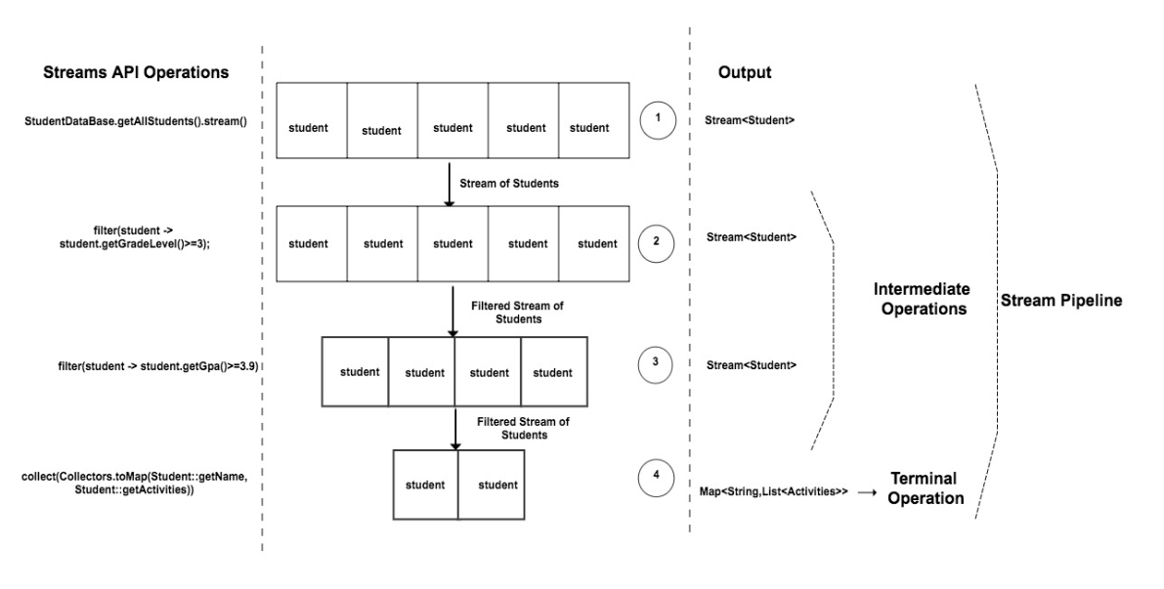
How Stream API Works ?

Slide 35
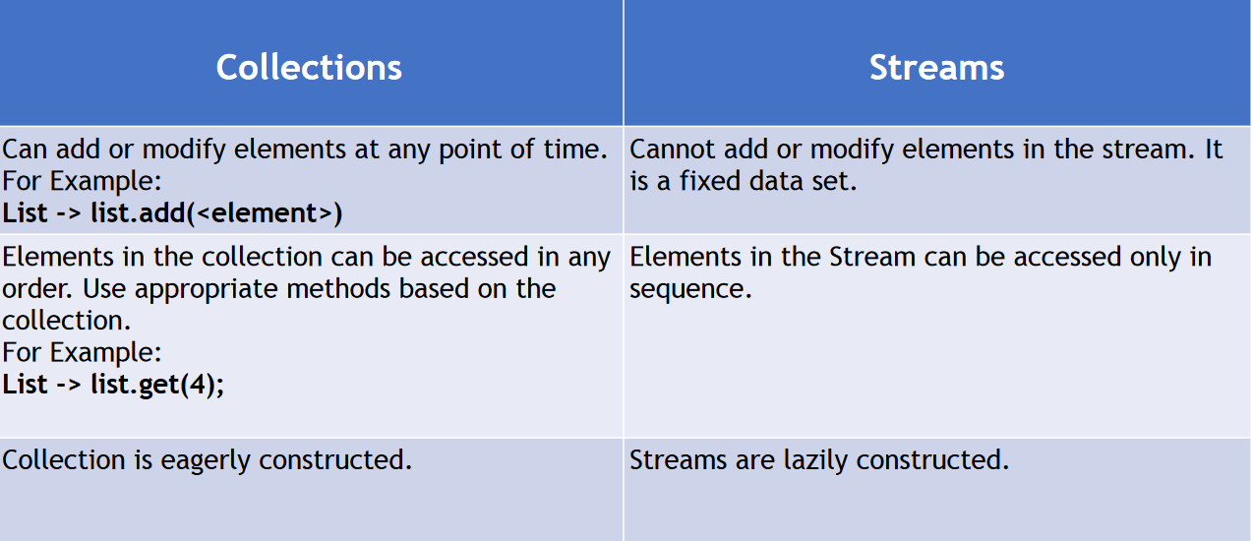
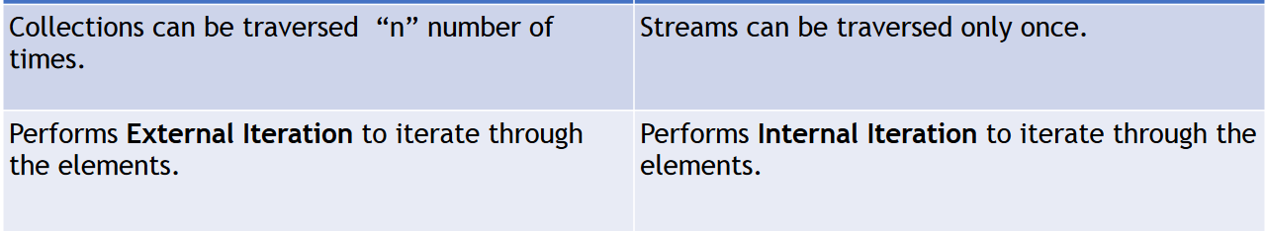
Collections and Streams

Slide 36
public class CollectionsVsStream {
public static void main(String[] args) {
ArrayList<String> names = new ArrayList<>();
names.add("adam");
names.add("jim");
names.add("jenny");
for(String name : names){
System.out.println(name);
}
for(String name : names){
System.out.println(name);
}
names.remove(0);
System.out.println(names);
Stream<String> nameStream = names.stream();
nameStream.forEach(System.out::println);
// nameStream.forEach(System.out::println);
}
}

Slide 37
public class StreamsExample {
public static void main(String[] args) {
//student name and there activities in a map
Predicate<Student> studentPredicate = (student -> student.getGradeLevel()>=3);
Predicate<Student> studentgpaPredicate = (student -> student.getGpa()>=3.9);
Map<String,List<String>> studentMap = StudentDataBase.getAllStudents().stream()
.filter(studentPredicate) //Stream<Students>
.filter(studentgpaPredicate)//Stream<Students>
.collect(Collectors.toMap(Student::getName,Student::getActivities)); //<Map>
System.out.println(studentMap);
LocalDate localDate = LocalDate.of(2018,06,24);
System.out.println(localDate);
LocalDate localDate1 = LocalDate.of(2018,06,20);
System.out.println(localDate1.isBefore(localDate));
System.out.println(DAYS.between(localDate1,localDate));
System.out.println(DAYS.between(localDate,localDate1));
IntStream.rangeClosed(0,(int) DAYS.between(localDate1,localDate))
.forEach((i) -> {
System.out.println(localDate1.plusDays(i));
});
IntStream.rangeClosed(0,0)
.forEach((i) -> {
System.out.println(localDate1.plusDays(i));
});
}
}

Slide 38
Stream API : map()
• map : Convert(transform) one type to another.
• Don’t get confused this with Map Collection.

Slide 39
public class StreamsMapExample {
public static List<String> namesList(){
List<String> studentList = StudentDataBase.getAllStudents().stream() //Stream<Student>
//Student as an input -> Student Name
.map(Student::getName) //Stream<String>
.map(String::toUpperCase) //Stream<String> -> uppercase operation on each input
.collect(toList()); //List<String>
return studentList;
}
public static Set<String> namesSet(){
Set<String> studentList = StudentDataBase.getAllStudents().stream() //Stream<Student>
//Student as an input -> Student Name
.map(Student::getName) //Stream<String>
.map(String::toUpperCase) //Stream<String> -> uppercase operation on each input
.collect(toSet()); //Set<String>
return studentList;
}
public static void main(String[] args) {
System.out.println(namesList());
System.out.println(namesSet());
}
}

Slide 40
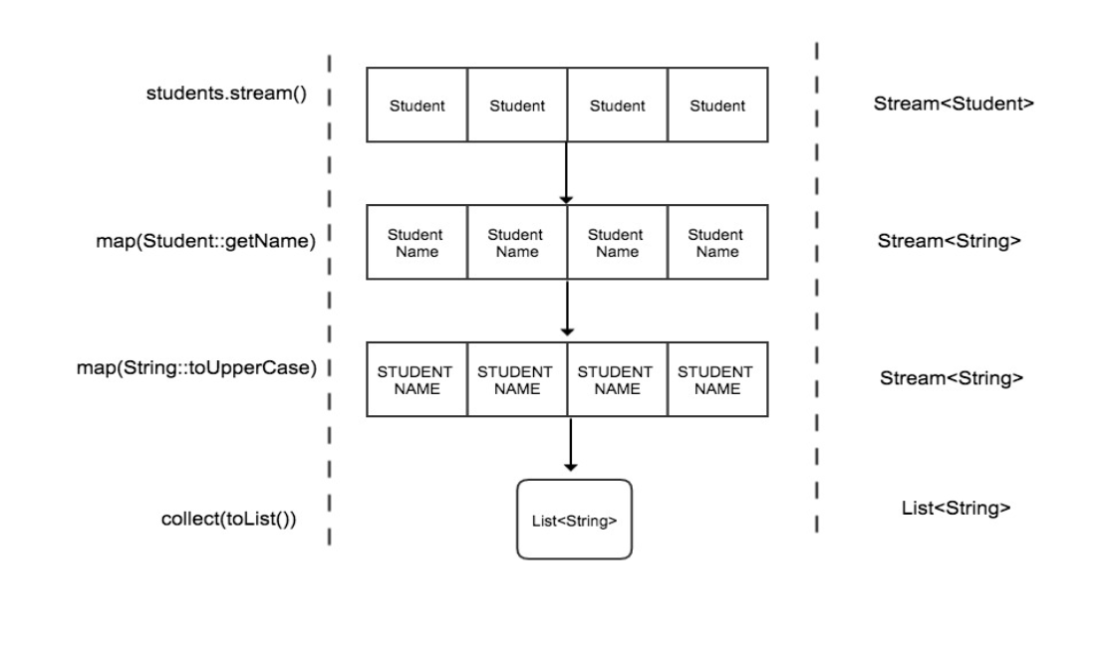

Slide 41
FlatMap
flatMap : Converts(Transforms) one type to another as like
map() method
• Used in the context of Stream where each element in the
stream represents multiple elements.
[
[1,2,3],
[1,2]
[3]
]

Slide 42
public class StreamsFlatMapExample {
public static List<String> printStudentActivities(){
List<String> studentActivities = StudentDataBase.getAllStudents().stream() //Stream<Student>
.map(Student::getActivities) //Stream<List<String>
.flatMap(List::stream) //Stream<String>
.collect(toList());
return studentActivities;
}
public static void main(String[] args) {
System.out.println("printStudentActivities : " + printStudentActivities());
}
}

Slide 43
Stream API – distinct() , count() and sorted()
• distinct – Returns a stream with unique elements
• count – Returns a long with the total no of elements in the
Stream.
• sorted - Sort the elements in the stream

Slide 44
public class StreamsFlatMapExample {
public static List<String> printStudentActivities(){
List<String> studentActivities = StudentDataBase.getAllStudents().stream() //Stream<Student>
.map(Student::getActivities) //Stream<List<String>
.flatMap(List::stream) //Stream<String>
.distinct()
.sorted()
.collect(toList());
return studentActivities;
}
public static long getStudentActivitiesCount(){
long noOfStudentActivities = StudentDataBase.getAllStudents().stream() //Stream<Student>
.map(Student::getActivities) //Stream<List<String>
.flatMap(List::stream) //Stream<String>
.distinct() //Stream<String> -> with distinct function performed
.count();
return noOfStudentActivities;
}
public static void main(String[] args) {
System.out.println("printStudentActivities : " + printStudentActivities());
System.out.println("getStudentActivitiesCount : " + getStudentActivitiesCount());
}
}

Slide 45
Stream API – filter()
• filter – filters the elements in the stream.
Input to the filter is a Predicate Functional Interface

Slide 46
public class StreamsFilterExample {
public static List<Student> filterStudents(){
return StudentDataBase.getAllStudents().stream() //Stream<Student>
.filter((student -> student.getGender().equals("female"))) //Stream<Student>
//filters and sends only the students whose gender is female
.filter(student -> student.getGpa()>=3.9)
.collect(toList());
}
public static void main(String[] args) {
//System.out.println("filterStudents : " + filterStudents());
filterStudents().forEach(System.out::println);
}
}

Slide 47
Streams API - reduce()
• reduce – This is a terminal operation. Used to reduce the contents of a stream to a single value.
• It takes two parameters as an input.
• First parameters – default or initial value
• Second Parameter – BinaryOperator<T>

Slide 48
public class StreamReduceExample {
public static int performMultiplication(List<Integer> integerList){
return integerList.stream()
//1
//3
//5
//7
.reduce(1,(a,b) -> a*b);
}
public static Optional<Integer> performMultiplicationWithoutIdentity(List<Integer> integerList){
return integerList.stream()
//1
//3
//5
//7
.reduce((a,b) -> a*b);
}
public static void main(String[] args) {
List<Integer> integers = Arrays.asList(1,3,5,7);
List<Integer> integers1 = new ArrayList<>();
System.out.println(performMultiplication(integers));
Optional<Integer> result = performMultiplicationWithoutIdentity(integers);
System.out.println(result.isPresent());
System.out.println(result.get());
Optional<Integer> result1 = performMultiplicationWithoutIdentity(integers1);
System.out.println(result1.isPresent());
if(result1.isPresent()){
System.out.println(result1.get());
}
}
}

Slide 49
public class StreamReduceExample {
public static int performMultiplication(List<Integer> integerList){
return integerList.stream()
//1
//3
//5
//7
.reduce(1,(a,b) -> a*b);
}
public static Optional<Integer> performMultiplicationWithoutIdentity(List<Integer> integerList){
return integerList.stream()
//1
//3
//5
//7
.reduce((a,b) -> a*b);
}
public static Optional<Student> getHighestGPAStudent(){
return StudentDataBase.getAllStudents().stream()
//students one by one
.reduce((s1,s2)->(s1.getGpa()>s2.getGpa()) ? s1 : s2);
}
public static void main(String[] args) {
List<Integer> integers = Arrays.asList(1,3,5,7);
List<Integer> integers1 = new ArrayList<>();
System.out.println(performMultiplication(integers));
Optional<Integer> result = performMultiplicationWithoutIdentity(integers);
System.out.println(result.isPresent());
System.out.println(result.get());
Optional<Integer> result1 = performMultiplicationWithoutIdentity(integers1);
System.out.println(result1.isPresent());
if(result1.isPresent()){
System.out.println(result1.get());
}
Optional<Student> studentOptional = getHighestGPAStudent();
if(getHighestGPAStudent().isPresent()){
System.out.println(studentOptional.get());
}
}
}

Slide 50
Stream API : Max/Min using reduce()
• max -> Maximum(largest) element in the stream.
• min -> Minimum(smallest) element in the stream.

Slide 51
package com.learnJava.streams;
import java.util.ArrayList;
import java.util.Arrays;
import java.util.List;
import java.util.Optional;
public class StreamsMinMaxExample {
public static int findMaxvalue(List<Integer> integerList){
return integerList.stream()
//6 -> y
//7 -> y
//8-> y
//9-> y
//10-> y
//x variable holds the max value for each element in the iteration
.reduce(0,(x,y)-> x>y ? x : y);
}
public static Optional<Integer> findMinvalue(List<Integer> integerList){
return integerList.stream()
//6 -> y
//7 -> y
//8-> y
//9-> y
//10-> y
//x variable holds the max value for each element in the iteration
.reduce((x,y)-> x<y ? x : y);
}
public static Optional<Integer> findMaxvalueOptional(List<Integer> integerList){
return integerList.stream()
//6 -> y
//7 -> y
//8-> y
//9-> y
//10-> y
//x variable holds the max value for each element in the iteration
.reduce((x,y)-> x>y ? x : y);
}
public static void main(String[] args) {
// List<Integer> integerList = Arrays.asList(6,7,8,9,10);
List<Integer> integerList = new ArrayList<>();
Optional<Integer> minValueOptional = findMinvalue(integerList);
System.out.println("minValueOptional : " + minValueOptional);
if(minValueOptional.isPresent()){
System.out.println("The minimum value is : " + minValueOptional.get());
}else{
System.out.println("No Input is passed");
}
/* int maxValue = findMaxvalue(integerList);
System.out.println(" max value is :" + maxValue);
Optional<Integer> maxValueOptional = findMaxvalueOptional(integerList);
System.out.println("Optional Max is : " + maxValueOptional);
if(maxValueOptional.isPresent()){
System.out.println("MaxValue using optional :" + maxValueOptional.get());
}else{
System.out.println("Input list is empty.");
}*/
}
}

Slide 52
Stream API : limit() and skip()
• These two function helps to create a sub-stream.
• limit(n) – limits the “n” numbers of elements to be processed
in the stream.
• skip(n) – skips the “n” number of elements from the stream.

Slide 53
package com.learnJava.streams;
import java.util.Arrays;
import java.util.List;
import java.util.Optional;
public class StreamsLimitSkipExample {
public static Optional<Integer> limit(List<Integer> integers){
return integers.stream()
//6
//7
//8
//9
//10
.limit(3) //6,7,8
.reduce((x,y)->x+y);
}
public static Optional<Integer> skip(List<Integer> integers){
return integers.stream()
//6
//7
//8
//9
//10
.skip(3)//9,10
.reduce((x,y)->x+y);
}
public static void main(String[] args) {
List<Integer> integers = Arrays.asList(6,7,8,9,10);
/*Optional<Integer> limitResult = limit(integers);
if(limitResult.isPresent()){
System.out.println("The limit result is :" + limitResult.get());
}else{
System.out.println("No input is passed");
}
*/
Optional<Integer> skipResult = skip(integers);
if(skipResult.isPresent()){
System.out.println("The skip result is :" + skipResult.get());
}else{
System.out.println("No input is passed");
}
}
}

Slide 54
Streams API : anyMatch(), allMatch() ,noneMatch()
• All these functions takes in a predicate as an input and returns
a Boolean as an output.
• anyMatch()- Returns true if any one of the element matches the
predicate, otherwise false.
• allMatch() - Returns true if all the element in the stream matches the
predicate, otherwise false.
• noneMatch() – Just opposite to allMatch(). Returns true if none of the
element in the stream matches the predicate, otherwise false.

Slide 55
package com.learnJava.streams;
import com.learnJava.data.StudentDataBase;
public class StreamsMatchExample {
public static boolean allMatch(){
return StudentDataBase.getAllStudents().stream()
.allMatch(student -> student.getGpa()>=3.5);
}
public static boolean anyMatch(){
return StudentDataBase.getAllStudents().stream()
.anyMatch(student -> student.getGpa()>=4.0);
}
public static boolean noneMatch(){
return StudentDataBase.getAllStudents().stream()
.noneMatch(student -> student.getGpa()>=4.0);
}
public static void main(String[] args) {
System.out.println("Result of All Match :" + allMatch());
System.out.println("Result of Any Match :" + anyMatch());
System.out.println("Result of none Match :" + noneMatch());
}
}

Slide 56
Streams API : findFirst() and findAny()
• Used to find an element in the stream.
• Both the functions returns the result of type Optional.
• findFirst() – Returns first element in the stream.
• findAny() – Returns the first encountered element in the
stream.

Slide 57
package com.learnJava.streams;
import com.learnJava.data.Student;
import com.learnJava.data.StudentDataBase;
import java.util.Optional;
public class StreamsFindAnyFirstExample {
public static Optional<Student> findAnyStudent(){
return StudentDataBase.getAllStudents().stream()
//adam
//jenny
//emily
.filter(student -> student.getGpa()>=3.9)
.findAny();
}
public static Optional<Student> findFirstStudent(){
return StudentDataBase.getAllStudents().stream()
//adam
//jenny
//emily
.filter(student -> student.getGpa()>=3.9)
.findFirst();
}
public static void main(String[] args) {
Optional<Student> studentOptionalFindAny = findAnyStudent();
if(studentOptionalFindAny.isPresent()){
System.out.println("Found The student : "+ studentOptionalFindAny.get());
}else{
System.out.println("Student Not Found !");
}
Optional<Student> studentOptionalFindFirst = findFirstStudent();
if(studentOptionalFindFirst.isPresent()){
System.out.println("Found The student : "+ studentOptionalFindFirst.get());
}else{
System.out.println("Student Not Found !");
}
}
}

Slide 58
Introduction to Optional
• Introduced as part of Java 8 to represent a Non-Null value
• Avoids Null Pointer Exception and Unnecessary Null Checks.

Slide 59
// Java program to illustrate
// optional class methods
import java.util.Optional;
class Main {
// Driver code
public static void main(String[] args)
{
// creating a string array
String[] str = new String[5];
// Setting value for 2nd index
str[2] = "Geeks Classes are coming soon";
// It returns an empty instance of Optional class
Optional<String> empty = Optional.empty();
System.out.println(empty);
// It returns a non-empty Optional
Optional<String> value = Optional.of(str[2]);
System.out.println(value);
}
}

Slide 60
package com.learnJava.optional;
import com.learnJava.data.Student;
import com.learnJava.data.StudentDataBase;
import java.util.Optional;
public class OptionalExample {
public static String getStudentName(){
//Student student = StudentDataBase.studentSupplier.get();
Student student = null;
if(student!=null){
return student.getName();
}
return null;
}
public static Optional<String> getStudentNameOptional(){
//Optional<Student> studentOptional = Optional.ofNullable(StudentDataBase.studentSupplier.get());
Optional<Student> studentOptional = Optional.ofNullable(null); // Optional.empty()
if(studentOptional.isPresent()){
studentOptional.get(); //Student
return studentOptional.map(Student::getName); //Optional<String>
}
return Optional.empty(); // Represents an optional object with no value
}
public static void main(String[] args) {
/*String name = getStudentName();
if(name!=null)
System.out.println("Length of the student Name : " + name.length());
else
System.out.println("Name not found");*/
Optional<String> stringOptional = getStudentNameOptional();
if(stringOptional.isPresent()){
System.out.println("Length of the student Name : " +
stringOptional.get().length()); //String which is Student Name
}else{
System.out.println("Name not found");
}
}
}

Slide 61
Java StringJoiner
Java added a new final class StringJoiner in java.util package. It is used to construct a sequence of characters separated by a delimiter. Now, you can create string by passing delimiters like comma(,), hyphen(-) etc. You can also pass prefix and suffix to the char sequence.

Slide 62
public class StringJoinerExample {
public static void main(String[] args) {
StringJoiner joinNames = new StringJoiner(","); // passing comma(,) as delimiter
// Adding values to StringJoiner
joinNames.add("Rahul");
joinNames.add("Raju");
joinNames.add("Peter");
joinNames.add("Raheem");
System.out.println(joinNames);
}
}

Slide 63
Java StringJoiner Example: adding prefix and suffix
public class StringJoinerExample {
public static void main(String[] args) {
StringJoiner joinNames = new StringJoiner(",", "[", "]"); // passing comma(,) and square-brackets as delimiter
// Adding values to StringJoiner
joinNames.add("Rahul");
joinNames.add("Raju");
joinNames.add("Peter");
joinNames.add("Raheem");
System.out.println(joinNames);
}
}

Slide 64
String input = "hello world example";
String delimiter = " ";
// Use StringJoiner to join the input string with the delimiter
StringJoiner joiner = new StringJoiner(delimiter);
for (String word : input.split(delimiter)) {
joiner.add(word);
}
String joinedString = joiner.toString(); // "hello world example"
// Split the joined string using the same delimiter to get the words
String[] words = joinedString.split(delimiter); // ["hello", "world", "example"]

Slide 65
public class Main {
public static void main(String[] args) {
StringJoiner stringJoiner = new StringJoiner(",", "#", "#");
stringJoiner.add("Interview");
stringJoiner.add("Questions");
stringJoiner.add("Answers");
System.out.println("String after adding # in suffix and prefix :");
System.out.println(stringJoiner);
}
}

Slide 66
public class Main {
public static void main(String[] args)
{
// Creating StringJoiner with delimiter " "
StringJoiner str1 = new StringJoiner(" ");
// Adding elements in the StringJoiner
str1.add("ABC");
str1.add("DEF");
str1.add("IJK");
// Print the StringJoiner
System.out.println("StringJoiner 1: "
+ str1.toString());
// Creating the second StringJoiner
StringJoiner str2 = new StringJoiner(" ");
str2.add("123");
str2.add("456");
str2.add("789");
// Print the second StringJoiner
System.out.println("StringJoiner 2: "
+ str2.toString());
// Merging the StringJoiner using merge()
StringJoiner str = str1.merge(str2);
// Printing the merged StringJoiner
System.out.println("Merged StringJoiner : "
+ str);
}
}

Slide 67
Parallel Sort
Java 8 introduced a new method called as parallelSort() in java.util.Arrays Class. It uses Parallel Sorting of array elements.
Advantage :
parallelSort() method uses concept of MultiThreading which makes the sorting faster as compared to normal sorting method.

Slide 68
// Java program to demonstrate
// Arrays.parallelSort() method
import java.util.Arrays;
public class ParallelSort {
public static void main(String[] args)
{
// Creating an array
int numbers[] = { 9, 8, 7, 6, 3, 1 };
// Printing unsorted Array
System.out.print("Unsorted Array: ");
// Iterating the Elements using stream
Arrays.stream(numbers).forEach(n -> System.out.print(n + " "));
System.out.println();
// Using Arrays.parallelSort()
Arrays.parallelSort(numbers);
// Printing sorted Array
System.out.print("Sorted Array: ");
// Iterating the Elements using stream
Arrays.stream(numbers).forEach(n -> System.out.print(n + " "));
}
}

Slide 69
Date-Time API
New date-time API is introduced in Java 8 to overcome the following drawbacks of old date-time API :
Not thread safe : Unlike old java.util.Date which is not thread safe the new date-time API is immutable and doesn’t have setter methods.
Less operations : In old API there are only few date operations but the new API provides us with many date operations.

Slide 70
Java 8 under the package java.time introduced a new date-time API, most important classes among them are :
Local : Simplified date-time API with no complexity of timezone handling.
Zoned : Specialized date-time API to deal with various timezones.

Slide 71
// Java code for LocalDate
// / LocalTime Function
import java.time.*;
import java.time.format.DateTimeFormatter;
public class Date {
public static void LocalDateTimeApi()
{
// the current date
LocalDate date = LocalDate.now();
System.out.println("the current date is "+
date);
// the current time
LocalTime time = LocalTime.now();
System.out.println("the current time is "+
time);
// will give us the current time and date
LocalDateTime current = LocalDateTime.now();
System.out.println("current date and time : "+
current);
// to print in a particular format
DateTimeFormatter format =
DateTimeFormatter.ofPattern("dd-MM-yyyy HH:mm:ss");
String formatedDateTime = current.format(format);
System.out.println("in formatted manner "+
formatedDateTime);
// printing months days and seconds
Month month = current.getMonth();
int day = current.getDayOfMonth();
int seconds = current.getSecond();
System.out.println("Month : "+month+" day : "+
day+" seconds : "+seconds);
// printing some specified date
LocalDate date2 = LocalDate.of(1950,1,26);
System.out.println("the republic day :"+date2);
// printing date with current time.
LocalDateTime specificDate =
current.withDayOfMonth(24).withYear(2016);
System.out.println("specific date with "+
"current time : "+specificDate);
}
// Driver code
public static void main(String[] args)
{
LocalDateTimeApi();
}
}

Slide 72
Zoned date-time API : Use it when time zones are to be considered
// Java code for Zoned date-time API
import java.time.LocalDateTime;
import java.time.ZoneId;
import java.time.ZonedDateTime;
import java.time.format.DateTimeFormatter;
public class Zone {
// Function to get Zoned Date and Time
public static void ZonedTimeAndDate()
{
LocalDateTime date = LocalDateTime.now();
DateTimeFormatter format1 =
DateTimeFormatter.ofPattern("dd-MM-yyyy HH:mm:ss");
String formattedCurrentDate = date.format(format1);
System.out.println("formatted current Date and"+
" Time : "+formattedCurrentDate);
// to get the current zone
ZonedDateTime currentZone = ZonedDateTime.now();
System.out.println("the current zone is "+
currentZone.getZone());
// getting time zone of specific place
// we use withZoneSameInstant(): it is
// used to return a copy of this date-time
// with a different time-zone,
// retaining the instant.
ZoneId tokyo = ZoneId.of("Asia/Tokyo");
ZonedDateTime tokyoZone =
currentZone.withZoneSameInstant(tokyo);
System.out.println("tokyo time zone is " +
tokyoZone);
DateTimeFormatter format =
DateTimeFormatter.ofPattern("dd-MM-yyyy HH:mm:ss");
String formatedDateTime = tokyoZone.format(format);
System.out.println("formatted tokyo time zone "+
formatedDateTime);
}
// Driver code
public static void main(String[] args)
{
ZonedTimeAndDate();
}
}

Slide 73
Marker Interface
An interface that does not have any methods, fields, or constants, i.e, an empty interface in java is known as Marker or Tag Interface. It is used to deliver type information at runtime to the JVM so that it can take some action based on the information received.
One of the main purposes behind the ideology of marker interfaces is that they are used to convey a message to the JVM that the class implementing this type of interface has some extra functionalities. Popular examples of marker interface in java include Cloneable, Serializable, Remote Interface.

Slide 74
Syntax-
public interface MyMarkerInterface {
}

Slide 75
Uses of Marker Interface
The main use of the Marker Interface in Java is to convey to the JVM that the class implementing some interface of this category has to be granted some special behavior.
e.g, when a class implements the Serializable interface, which is a marker interface, then this is an indication to the JVM that the objects of this class can be serialized. Similarly, when a class implements Cloneable Interface, then it indicates to the JVM that the objects of this class can be cloned.

Slide 76
Cloneable Interface: Cloneable Interface in Java is a marker interface. It belongs to java.lang package. It is used to create a clone or copy of an object with some other name. If we want to clone the objects of a class, then that class has to implement the Cloneable interface. This is used to indicate the JVM that the clone() method of the Object class can be used by the objects of the class which have implemented the Cloneable Interface.

Slide 77
import java.io.*;
import java.util.*;
import java.lang.Cloneable;
public class Plant implements Cloneable{
String name;
int height;
int leaves;
public Plant(String s, int h, int l) {
name = s;
height = h;
leaves = l;
}
public String toString() {
return "Name: " + name + ", Height: " + height + ", Leaves: " + leaves;
}
public static void main(String[] args) throws CloneNotSupportedException{
// Creating an object
Plant p1 = new Plant("Tree", 10, 100);
System.out.println("Plant p1: " + p1);
// Creating clone of the object p1
Plant p2 = (Plant) p1.clone();
System.out.println("Clone of p1: " + p2);
}
}

Slide 78
instanceOf
instanceof is a keyword that is used for checking if a reference variable is containing a given type of object reference or not.

Slide 79
// Java Program to Illustrate instanceof Keyword
// Importing required I/O classes
import java.io.*;
// Main class
class Main {
public static void main(String[] args)
{
// Creating object of class inside main()
Main object = new Main();
// Returning instanceof
System.out.println(object instanceof Main);
}
}

Slide 80
Eg-
// Java program to demonstrate working of instanceof Keyword
// Class 1
// Parent class
class Parent {}
// Class 2
// Child class
class Child extends Parent {}
// Class 3
// Main class
class Main {
// Main driver method
public static void main(String[] args)
{
// Creating object of child class
Child cobj = new Child();
// A simple case
if (cobj instanceof Child)
System.out.println("cobj is instance of Child");
else
System.out.println(
"cobj is NOT instance of Child");
// instanceof returning true for Parent class also
if (cobj instanceof Parent)
System.out.println(
"cobj is instance of Parent");
else
System.out.println(
"cobj is NOT instance of Parent");
// instanceof returns true for all ancestors
// Note : Object is ancestor of all classes in Java
if (cobj instanceof Object)
System.out.println(
"cobj is instance of Object");
else
System.out.println(
"cobj is NOT instance of Object");
}
}

Slide 81
Instance Initialization Block (IIB)
In a Java program, operations can be performed on methods, constructors, and initialization blocks. Instance Initialization Blocks or IIBs are used to initialize instance variables. So firstly, the constructor is invoked and the java compiler copies the instance initializer block in the constructor after the first statement super(). They run each time when the object of the class is created.
Initialization blocks are executed whenever the class is initialized and before constructors are invoked.
They are typically placed above the constructors within braces.
It is not at all necessary to include them in your classes.

Slide 82
// Java program to illustrate
// execution of multiple
// Instance Initialization Blocks
// in one program
class Main {
// Instance Initialization Block - 1
{
System.out.println("IIB1 block");
}
// Instance Initialization Block - 2
{
System.out.println("IIB2 block");
}
Main() { System.out.println("Constructor Called"); }
// Instance Initialization Block - 3
{
System.out.println("IIB3 block");
}
// main function
public static void main(String[] args)
{
Main a = new Main();
}
}

Slide 83
volatile Keyword
Using volatile is yet another way (like synchronized) of making class thread-safe. Thread-safe means that a method or class instance can be used by multiple threads at the same time without any problem.
The volatile keyword can be used either with primitive type or objects. The volatile keyword does not cache the value of the variable and always read the variable from the main memory. The volatile keyword cannot be used with classes or methods. However, it is used with variables.

Slide 84
class VolatileData
{
private volatile int counter = 0;
public int getCounter()
{
return counter;
}
public void increaseCounter()
{
++counter; //increases the value of counter by 1
}
}
class VolatileThread extends Thread
{
private final VolatileData data;
public VolatileThread(VolatileData data)
{
this.data = data;
}
@Override
public void run()
{
int oldValue = data.getCounter();
System.out.println("[Thread " + Thread.currentThread().getId() + "]: Old value = " + oldValue);
data.increaseCounter();
int newValue = data.getCounter();
System.out.println("[Thread " + Thread.currentThread().getId() + "]: New value = " + newValue);
}
}
public class VolatileMain
{
private final static int noOfThreads = 2;
public static void main(String[] args) throws InterruptedException
{
VolatileData volatileData = new VolatileData(); //object of VolatileData class
Thread[] threads = new Thread[noOfThreads]; //creating Thread array
for(int i = 0; i < noOfThreads; ++i)
threads[i] = new VolatileThread(volatileData);
for(int i = 0; i < noOfThreads; ++i)
threads[i].start(); //starts all reader threads
for(int i = 0; i < noOfThreads; ++i)
threads[i].join(); //wait for all threads
}
}

Slide 85
Java Enums
The Enum in Java is a data type which contains a fixed set of constants.
class EnumExample4{
enum Season{
WINTER(5), SPRING(10), SUMMER(15), FALL(20);
private int value;
private Season(int value){
this.value=value;
}
}
public static void main(String args[]){
for (Season s : Season.values())
System.out.println(s+" "+s.value);
}}

Slide 86
Can we create the instance of Enum by new keyword?
No, because it contains private constructors only.

